Slide 1
Noise
EE202
yanyan.wu@xjtlu.edu.cn
Department of Electronics and Electrical Engineering
Xi’an Jiaotong – Liverpool University

Slide 2
Contents
Noise Figure
AWGN

Slide 3
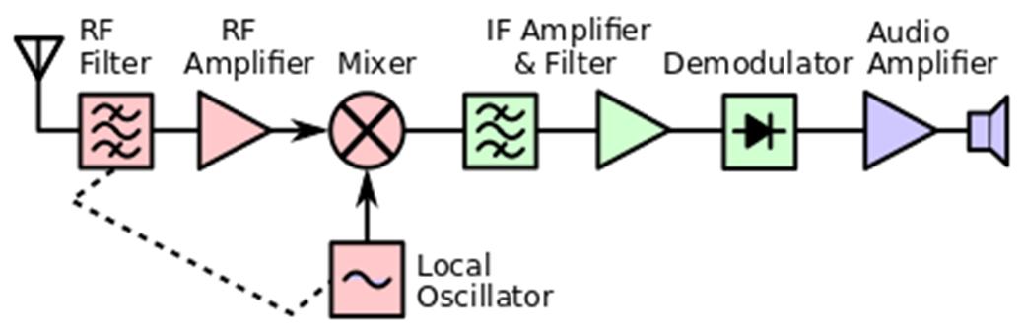
Noise @Receiver
The thermal noise arising from the thermal motion of electrons in a conducting medium , is introduced immediately following the receiving antenna throughout a receiver

Slide 4
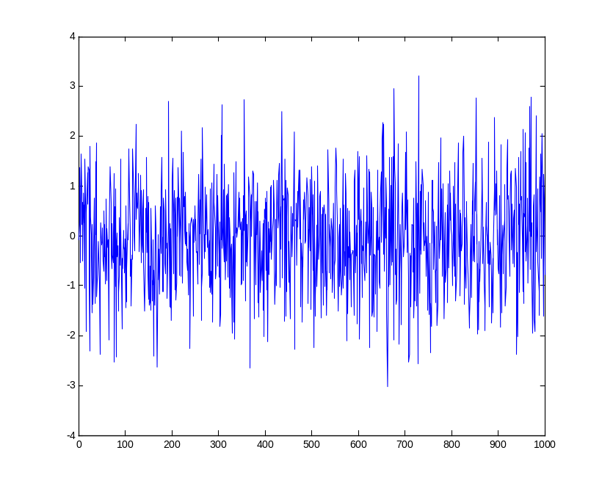
Gaussian Random Process
Gaussian (normal) random process: At a particular time t, the signal amplitude is Gaussian distributed.
A Gaussian process can be completely specified by the mean and autocorrelation.

Slide 5
AWGN as a Random Process
We usually consider additive white Gaussian noise (AWGN) in communications.
If the noise is white, then all frequency components appear with equal power (white is used in white light for a similar reason)
Generally noise can be modeled as a zero mean Gaussian WSS random process.

Slide 6
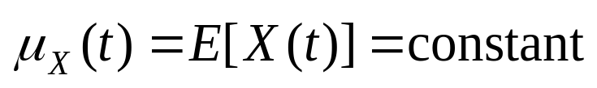
Stationary Process in Wide Sense
A random process is said to be wide sense stationary (WSS) if and only if
  1.
  2.
a WSS process is characterized by a constant mean and a one-dimensional autocorrelation function that only depends on the time difference τ.

Slide 7
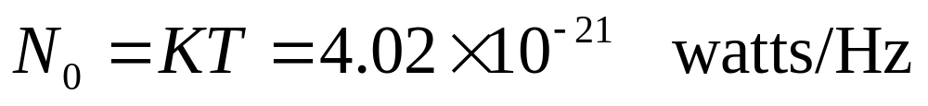
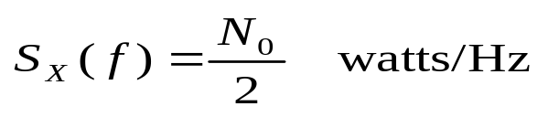
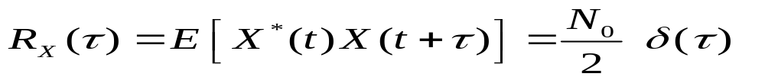
AWGN
For most applications
T=temperature of the resistor in Kelvin (290K)
K=Boltzmann’s constant 1.38x10⁻²³ joule/K
The power spectrum density (PSD) of noise is flat
and the noise bandwidth is infinite.
This implies that the autocorrelation is
Both are artifacts of the white noise model, since the unfiltered white noise would have an infinite power owing to its unlimited bandwidth. In fact thermal noise cannot be obtained over unlimited bandwidth, and doesn’t have infinite average power. See following slides.
S_{X}(f)
N₀/2
0
f
R_{X}(τ)
N₀/2
0
t

Slide 8
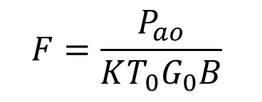
Noise Figure
RF frond end
Baseband
T₀
G₀ B
Output Noise P_{ao}
Noise Figure
P_{ao} =KT G₀B+KT₀G₀B(F-1)
or
P_{ao} =K(T+T_{e})G₀B where T_{e}=T₀(F-1)

Slide 9
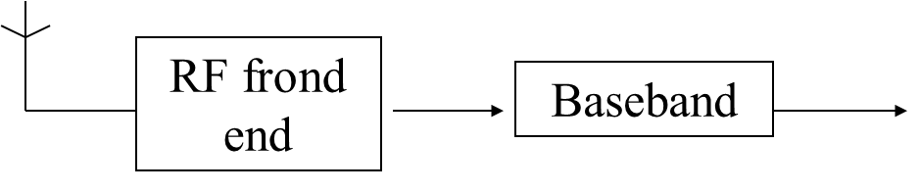
Class Activity
Assume that the signal power referenced to the RF front is -100 dBm, the bandwidth of both antenna and RF unit is 10 MHz, the gain of power amplifier is 40dB, the overall noise figure of RF unit is 8 dB and noise temperature is 300K. Boltzmann’s constant 1.38x10⁻²³ joule/K.
Determine the signal to noise ratio (SNR) in dB referenced to the input of RF front.
( signal:-100 dBm, noise: KTB=4.14*10^(-11) mw=-104dBm , SNR:4dB)
2. Determine the signal to noise ratio (SNR) in dB referenced to the input of baseband detector.
(signal: -60dbm ;
noise =KT G ₀B+KT ₀G₀B(F-1)=KG₀B(T+T₀(F-1))) =-56dBm
SNR: -4dB)

Slide 10
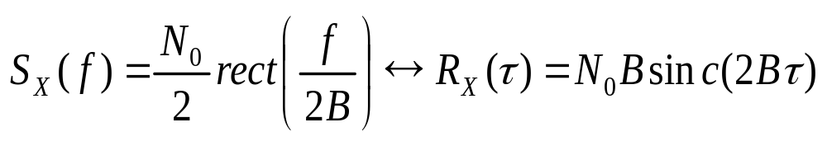
Bandlimited White Noise
In baseband communication, we pass our incoming signals through a low-pass filter. The resultant noise is said to be bandlimited:
The power of the bandlimited noise is N₀B.
S_{X}(f)
S_{X}(f)
White noise
Bandlimited White noise
N₀/2
N₀/2
Filter
Bandwidth BHz
-B
0
0
B
Notes:
a random process whose spectral amplitude is constant over a finite range of frequencies, and zero outside the range

Slide 11
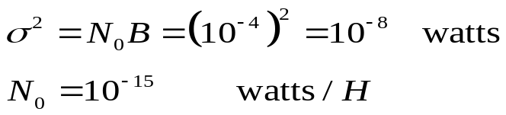
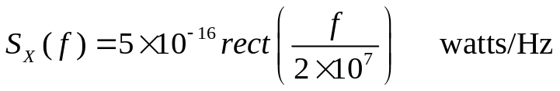
Example 1.2
The root mean square (rms) voltage measured at the output of an baseband amplifier due to internal noise is 100μV. If we assume that the frequency spectrum of the noise is flat from 0 to 10MHz and zero above 10MHz, find: (a) The spectral density function for the noise; (b) The autocorrelation function for the noise.
The rms value of Gaussian noise is the standard deviation σ.
  The bandwidth of the filter is B=10MHz
S_{X}(f)
f
-10MHz
10MHz

Slide 12
Passband White Noise
In bandpass communications (with modulation), we are interested in passband signals. That is, signals of which the carrier frequency is much larger than the bandwidth of the system.
The resultant noise is said to be passband:
The noise power of the passband noise is still N₀B
S_{X}(f)
B
B
N₀/2
f
-f_{c}
f_{c}

Slide 13
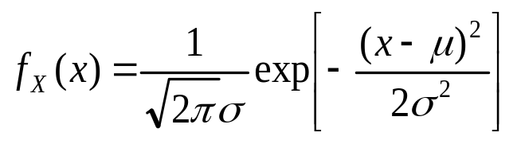
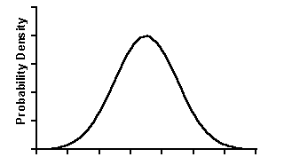

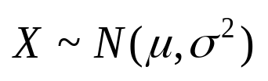
Gaussian Distribution
The R.V. X is called Gaussian (normal) if its pdf is:
μ--mean of X, --variance of X.
A Gaussian distribution is completely specified by its mean and variance. We write a Gaussian R.V. X as:
f_{X}(x)
x
x=μ

Slide 14
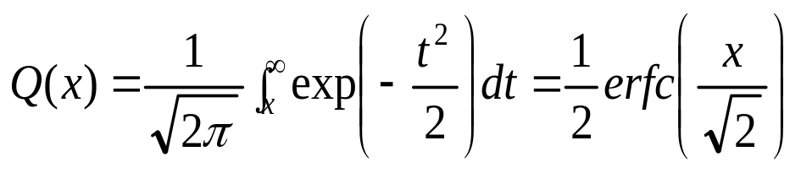
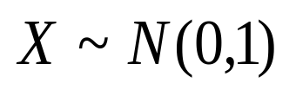
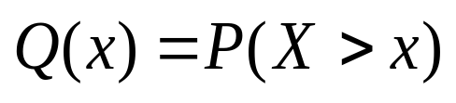
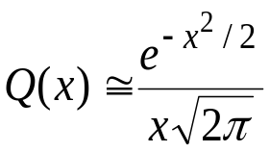
Gaussian Distribution: Q-function
We define a useful Q-function as
If , then
(Practice: Build Q-function in MATLAB using a predefined function erfc)
Properties of Q-function:
  Q(-x)=1-Q(x) (Proof: your homework)
  Q(0)=0.5
  When x>>1,

Slide 15
Ergodic Process
A random process is ergodic if, time averages obtained from a single realization are equal to the statistical (ensemble) averages .
Mean-ergodic process
Correlation-ergodic process

Slide 16
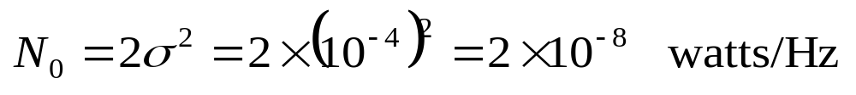
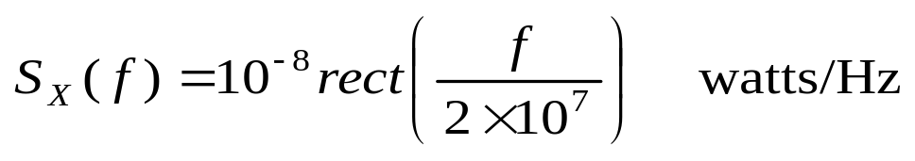
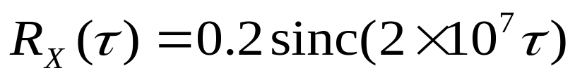
Example 1.2
The root mean square (rms) voltage measured at the output of an amplifier due to internal noise is 100μV. If we assume that the frequency spectrum of the noise is flat from 0 to 10MHz and zero above 10MHz, find: (a) The spectral density function for the noise; (b) The autocorrelation function for the noise.
  The rms value of Gaussian noise is the standard deviation σ.
  The bandwidth of the filter is B=10MHz
S_{X}(f)
f
-10MHz
10MHz

